Slide 1


The Balking Pattern
Zenith Kile

Slide 2




Table of contents
01
02
03
04
What is the Balking Pattern?
Pros and Cons
What about the State Pattern?
Original Code Example

Slide 3




Balk:
To stop before continuing towards an obstacle

Slide 4



What is the Balking Pattern?
A software design pattern where an action can only execute if an object is in a particular state.
If the object’s state is not valid, the action will “balk” at the request. This can be done through:
Throwing an exception
Causing an error
Following this, the action will attempt to repeat after a set amount of time.
This pattern is commonly used in programs that use multithreading.

Slide 5
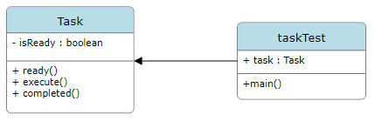


Generic Code

Slide 6
Pros and Cons of the Balking Pattern
Pros
Cons
Easy to understand pattern
Improves reliability
Efficient use of synchronization in concurrent programming.
Reduces errors
Could stall indefinitely
Could increase synchronization overhead
Can delay critical actions
Can be considered an “Anti-Pattern”

Slide 7
What about the State Pattern?
State pattern can be used in conjunction with the balking pattern.
The balking pattern only helps with ensuring that a state is correct before executing an action. The creation of a state is not affected.

Slide 8
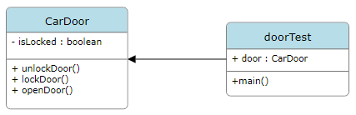
Original Code

Slide 9
Conclusion
The balking pattern is a great way to prevent errors when executing actions that have to do with the state of an object. Some consider it an anti-pattern because it can both: stall indefinitely and cause critical procedures to stall because a task is in front of it. Finally, it can be used alongside the state pattern without interfering with the other pattern’s purpose.

Slide 10



Thanks!
Do you have any questions?
Please keep this slide for attribution

